Slide 1
Rajeswari vedachalam govt. arts college chengalpattu p.g department [computer science] liver disease prediction
Guide name : Dr. T.Vani
TEAM MEMBER’S NAME: VENI.N
NANDHINI.D
MONISHA.D
GEETHALAKSHMI.S

Slide 2
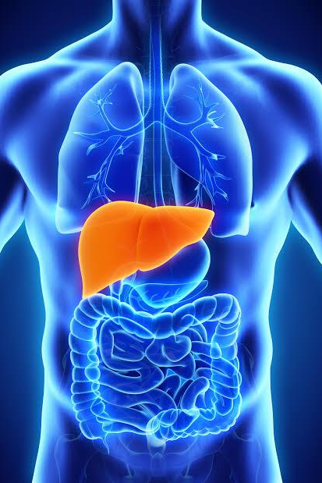
INTRODUCTION:
Liver is the largest organ in the body.Liver diseases are becoming one of the most fatal disease in several countries.
Patients with Liver disease have been continuously increasing because of excessive consumption of alcohol, inhale of harmful gases, intake of contaminated food, pickles and drugs.
OBJECTIVE:
The key objective of this study is to implement a web application to automatically diagnose the liver disease at an early stage using(ML) algorithms.

Slide 3
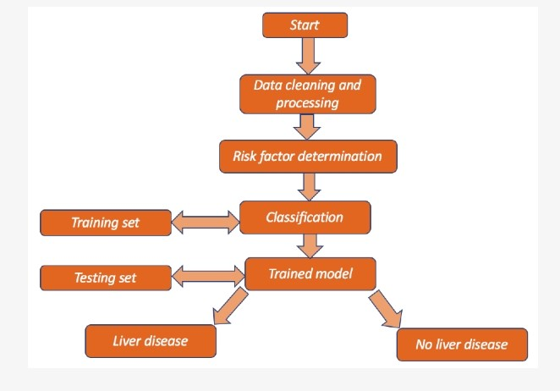
Project flow:
Data Collection & Preparation
Exploratory Data Analysis
Model Building
Performance Testing
Model Deployment

Slide 4
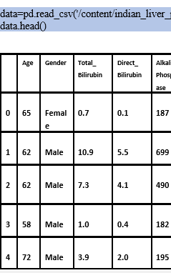
DATA COLLECTION & PREPARATION:
Collecting and preparing the dataset is one of the most crucial parts while creating an ML project.
Download the dataset from(Kaggle) open sources.
Importing the necessary libraries.
Read the Dataset.
Data Preparation Steps: Handling Missing Values , Handling Categorical Values.

Slide 5
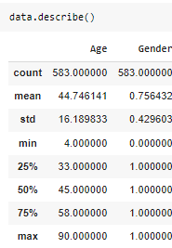
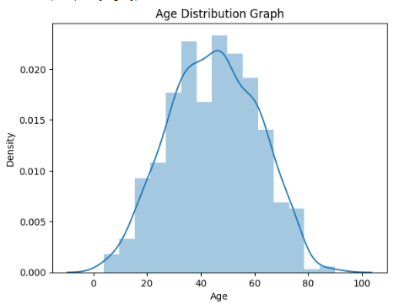
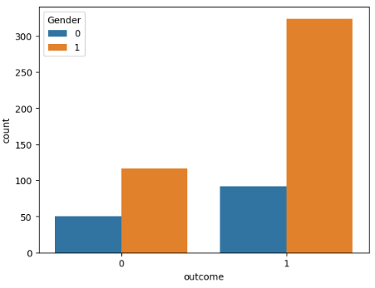
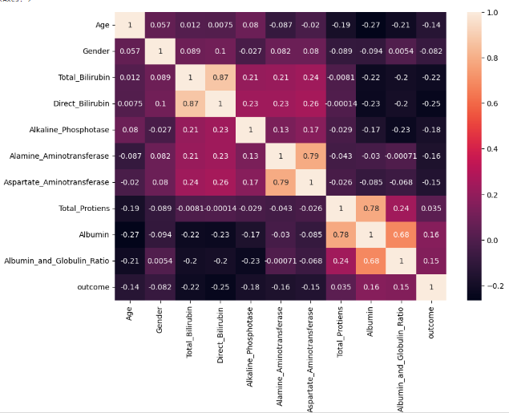
EXPLORATORY DATA ANALYSIS:
Exploratory Data Analysis(EDA) is an approach to analyse the data using visual techniques.
Descriptive analysis is to study the basic features of data with the statistical process.
Visual analysis is the process of using visual representations , such as charts, plots , graphs to explore and understand data.
Univariate analysis is understanding the data with a single feature.
Bivariate analysis is used two variable and compare them.
Multivariate analysis is to find the relation between multiple features.

Slide 6
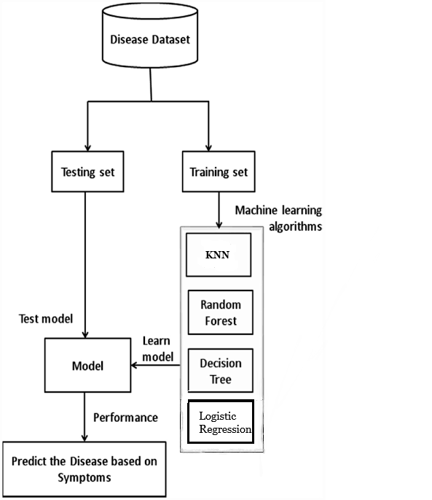
MODEL BUILDING:
In this step ,train our data on different algorithms.
Four Classification Algorithm: Random Forest Classifier, Decision Tree Model, KNN Model, Logistic Regression Model.
Building and training an Artificial Neural Network (ANN ) model using Keras library with Tensorflow as the backend.
Testing the model .

Slide 7
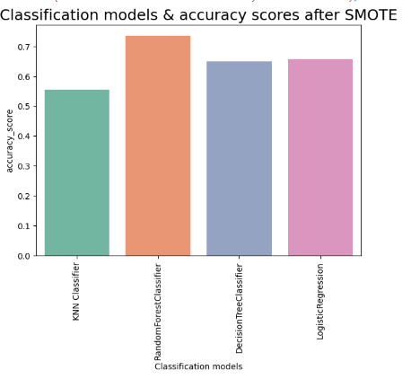
PERFORMANCE TESTING:
Testing model with multiple evaluation metrics.
Comparing the four models .
From the four models Random Forest Classifier
is performing well.
Random Forest Classifier is giving the accuracy of
84 percent.

Slide 8
MODEL DEPLOYMENT:
Saving the best model after comparing its performance into pickle file.
Building a web application that is integrated to the model.
Building Html Pages and Build Python code to run the web application.

Slide 9
CONCLUSION:
This project develop using machine learning with python.
This project compares various classification algorithms such as Random Forest, Logistic Regression,
KNN and ANN Algorithm with an aim to identify the best technique.
Based on this study, Random Forest with the highest accuracy outperformed the other algorithms.
REFERENCE:
Sontakke, Sumedh, Jay Lohokare, and Reshul Dani. "Diagnosis of liver diseases using machine
learning." 2017 International Conference on Emerging Trends & Innovation in ICT (ICEI). IEEE, 2017.
Wu, Chieh-Chen, et al. "Prediction of fatty liver disease using machine learning algorithms.“
Computer methods and programs in biomedicine 170 (2019): 23-29.
Khan, Rayyan Azam, Yigang Luo, and Fang-Xiang Wu. "Machine learning based liver disease diagnosis: A systematic review." Neurocomputing 468 (2022): 492-509.

Slide 10
THANK YOU…

